Slide 1

UNIVERSITY OF PETROLEUM & ENERGY STUDIES
School of Computer Science Dehradun
COURSE: Physical and IT Security
July – December 2023
Delivered by
Dr. Gopal Singh Rawat
1

Slide 2
Course Plan
CO1. Introduction to Physical Security CO2. Approaches to Physical Security CO3. Standards, Regulations and Guidelines CO4. Fire and Fire Safety Inspection
CO5. Vulnerability Assessment
CO6. Security Surveys and Audit CO7. Security Lighting, Alarms
CO8. Video, Biometrics, Access Control, Fences CO09. Security Personnel
2

Slide 3
Chapter 2. Approaches to Physical Security
Sub Topics:
Spectrum (Range) of Physical Security Approaches
Wide Array of Security Measures

Slide 4
2.1 Layers of Physical Security
Four Main Layers of Physical Security:
Design
Structures designed / built to impede, deter, mitigate or limit attacks
Consider → Limit entry/exit points, limit movement within area, additional steel / concrete (reinforced structure)
Fences, Wires, Speed breakers, Walls, Doors, Gates, Building, Lobbies, Access Control, Bunkers
Detection
Difficult to block determined attackers, but required to implement measures to find attacks
Motion sensors and Lights, Cameras, Human guards
Identification
Ensure authorized personnel are entering the facility / secure area
Retina scan, Fingerprint Scan, Voice Recognition, Digital Signature verification, ID Card
Control
Limiting access to secure areas to stop unauthorized personnel
Electronic, Mechanical, Procedural
Lock-code on doors, Check Points, Electronic Access Points, Key Locked doors

Slide 5
2.2 Physical Security Tools and Techniques
To implement Physical Controls → protect assets → understand organization environment →
Location of organization’s assets
Type of Vulnerabilities, Threats and Risks associated with those assets
Physical Security Controls:
Security in Layers
Technical Controls
Logging Controls
Perception as Physical Security

Slide 6
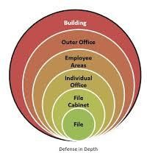
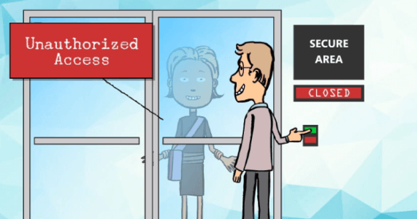
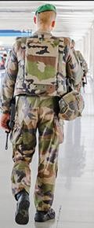
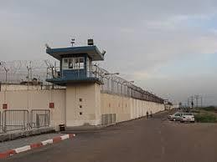
Physical Security Controls: Security in Layers
#1 Outer Layer:
Aspects –
Location of facility - in a city, mall, shop, outside city, jungle/remote
Type of facility - office, shop, factory, university, warehouses, Army /Defense base
Elements of Outer Layer:
Natural Barriers – water body, hills, rocks on one side
Structural Barriers – man-made/implemented – to protect the area, delay unnecessary requests, direct traffic/access
Common Outer Layer Structural Barriers: Fences, Walls, Gates
#2 Inner Layer:
Comprises of the facility building of the organization
Common Inner Layer Barriers: Locks, Keys/Combinations, Patrols, Guards

Slide 7
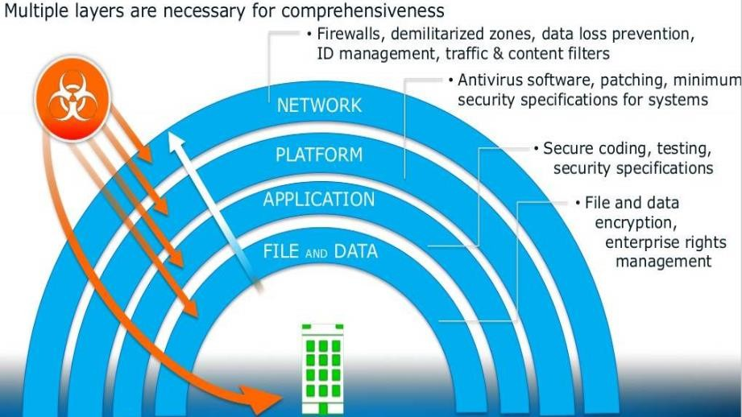
2.2.1 Cyber Security Controls: Security in Layers

Slide 8
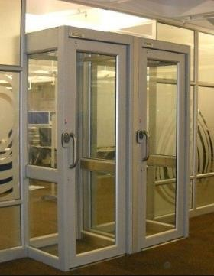
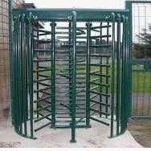
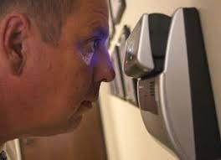

2.2.2 Physical Security Controls: Technical Controls
Man Traps →
Highly Secure Areas, Authentication + Visual Identification required
Turnstiles →
Control entry and exit, allowing one person to pass at a time after authorization is confirmed
More effective, Crowd control, Loss prevention, Access control
Biometrics →
Retina/Finger scanners, Facial Recognition Apps (AI/Algorithms), Key Stroke/Speed Recognition
CCTV Surveillance →
video record, cameras, camcorders, motion sensor cams

Slide 9
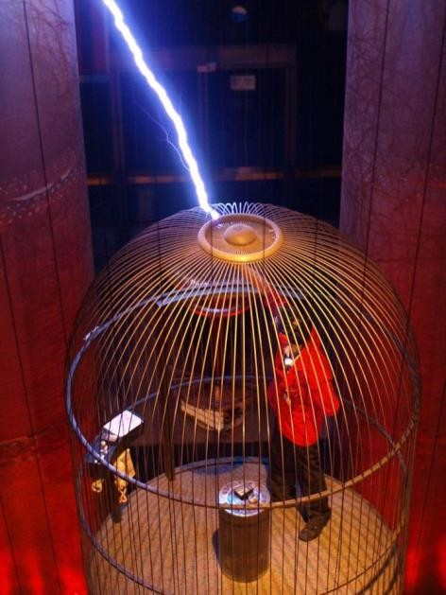
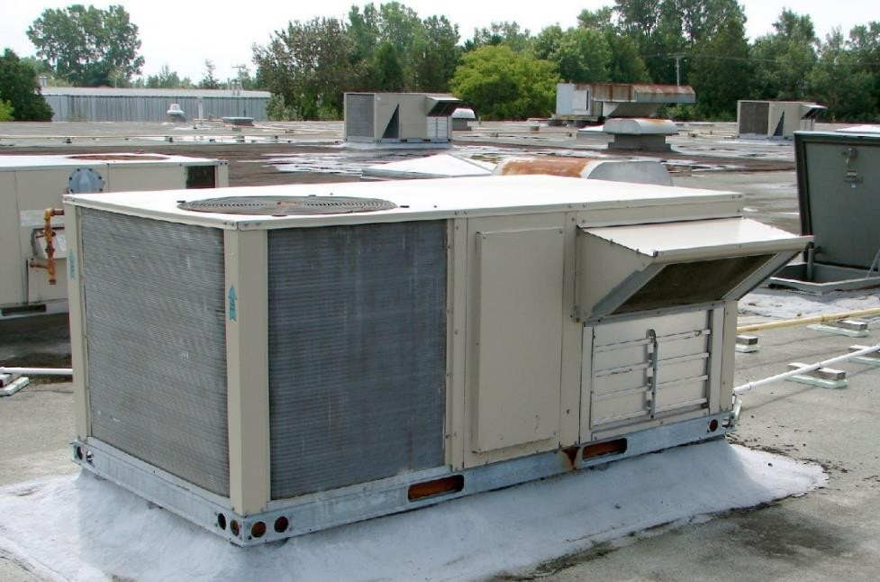
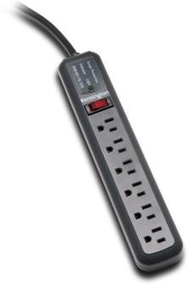
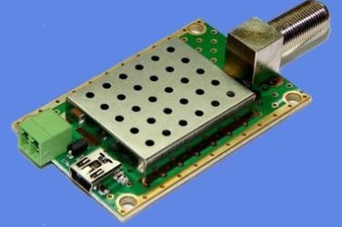
2.2.3 Physical Security Controls: Environmental & Power Control
Environmental Monitoring
Heat (H), Ventilation (V) Temperature/Humidity, Air Conditioning (AC) → HVAC
Power Systems
AC/DC provision → Surge Protectors, Power Conditioners (Stabilizers), Backup (UPS – Battery/Solar)
EMI Shielding
Electronic Emissions from Computers & signal lines should be grounded/shielded - interfere with info processing
Circuit overload, Spikes
Faraday Cage – shield from Electronic Emissions

Slide 10
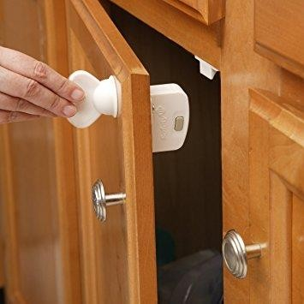
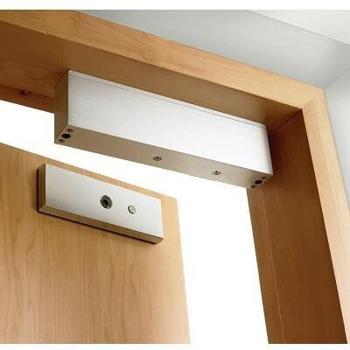
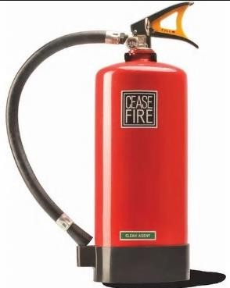
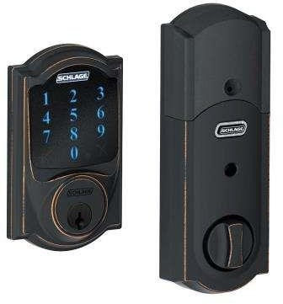
2.2.3 Physical Security Controls: Environmental & Power Control
Fire Suppression
Extinguishers use Portable, use Pull (P), Aim (A), Squeeze (S), Sweep (S) procedure
Types of fire: A (Paper/Wood), B (Flammable liquids/Chemical), C (Flammable Electrical), D (Flammable Metals)
Electromagnetic and Electronic Locks
Parts that have been manipulated / tempered: Lock Picking
Cases that make lock inoperable: Drilling
Magnetic Locks
Utilizes force of magnet, has parts which can be moved

Slide 11
2.2.4 Physical Security Controls: Logging Controls
Access Logs / Audit Trails
Generated by Physical Access Control systems should be reviewed regularly (not just keep a guard/control)
Date/Time, Entry/Exit Door#, Employee ID, Failed Attempts
These are not preventive but investigative / detective in nature
Help lower the vulnerabilities but no immediate action is taken
2.2.5 Physical Security Controls: Perception as Protection
Perception –
Mindset develop of everyone involved (Business Owners, Staff, Guards, Visitors, Third Party/Vendors)
Identify Security issues and Use / integrate security into existing security plan.
Approaches:
Visible with Real Protection – Guard, Road Blocks, Signs
Not Visible with Real Protection – CCTV (hidden)
Illusion incorporated as Protection
New MAC – set new password
Leaving Employee machine checks
Buy as Guest giving your CC#

Slide 12
2.2.5 Physical Security Controls: Security Containers / Storage Area Security
Use of Storage Containers:
Classified documents (Design, Source Code, Configuration), Components, Equipment, Funds, Valuables, Weapons
Security Containers Types:
Security Containers Features defined as per “Resistance against” in terms of minutes/hours
Forced Entry – after how many minutes
Surreptitious Entry – Sneaking/Stealth/Secret
Lock Manipulation – manipulate components of lock to open w/o original key
Radiological attack – being in contact with radio-active material with intent to harm
E.g. H3 Uranium, Iridium-192, Cobalt-60, Tritium, Radon Gas, Potassium-40
Definition: any element that losses or absorbs one or more neutrons than its stable form.

Slide 13
2.2.5 Physical Security Controls: Security Containers / Storage Area Security
Security Containers : Six Classes
Class 1
Resistance against forced entry: 20 man minutes
Resistance against Surreptitious entry: 20 man minutes
Resistance against Lock manipulation : 20 man hours
Resistance against Radiological attack : 20 man hours
Wheels: Non metallic
Class 2
Resistance against forced entry: 5 man minutes
Resistance against Surreptitious entry: 20 man minutes
Resistance against Lock manipulation : 20 man hours
Resistance against Radiological attack : 20 man hours
Wheels: metallic
Class 3
Resistance against forced entry: none
Resistance against Lock manipulation : 20 man hours
Resistance against Radiological attack : 20 man hours

Slide 14
2.2.5 Physical Security Controls: Security Containers / Storage Area Security
Security Containers : Six Classes
Class 4
Resistance against forced entry: 5 man minutes
Resistance against Surreptitious entry: 30 man minutes
Resistance against Lock manipulation : 2 man hours
Resistance against Radiological attack : 20 man hours
Class 5
Resistance against forced entry: 10 man minutes
Resistance against Surreptitious entry: 30 man minutes
Resistance against Lock manipulation : 20 man hours
Resistance against Radiological attack : 20 man hours
Wheels: metallic
Class 6
Resistance against forced entry: none
Resistance against Surreptitious entry: 30 man minutes
Resistance against Lock manipulation : 20 man hours
Resistance against Radiological attack : 20 man hours

